Slide 1
What can I share online?
By

Slide 2
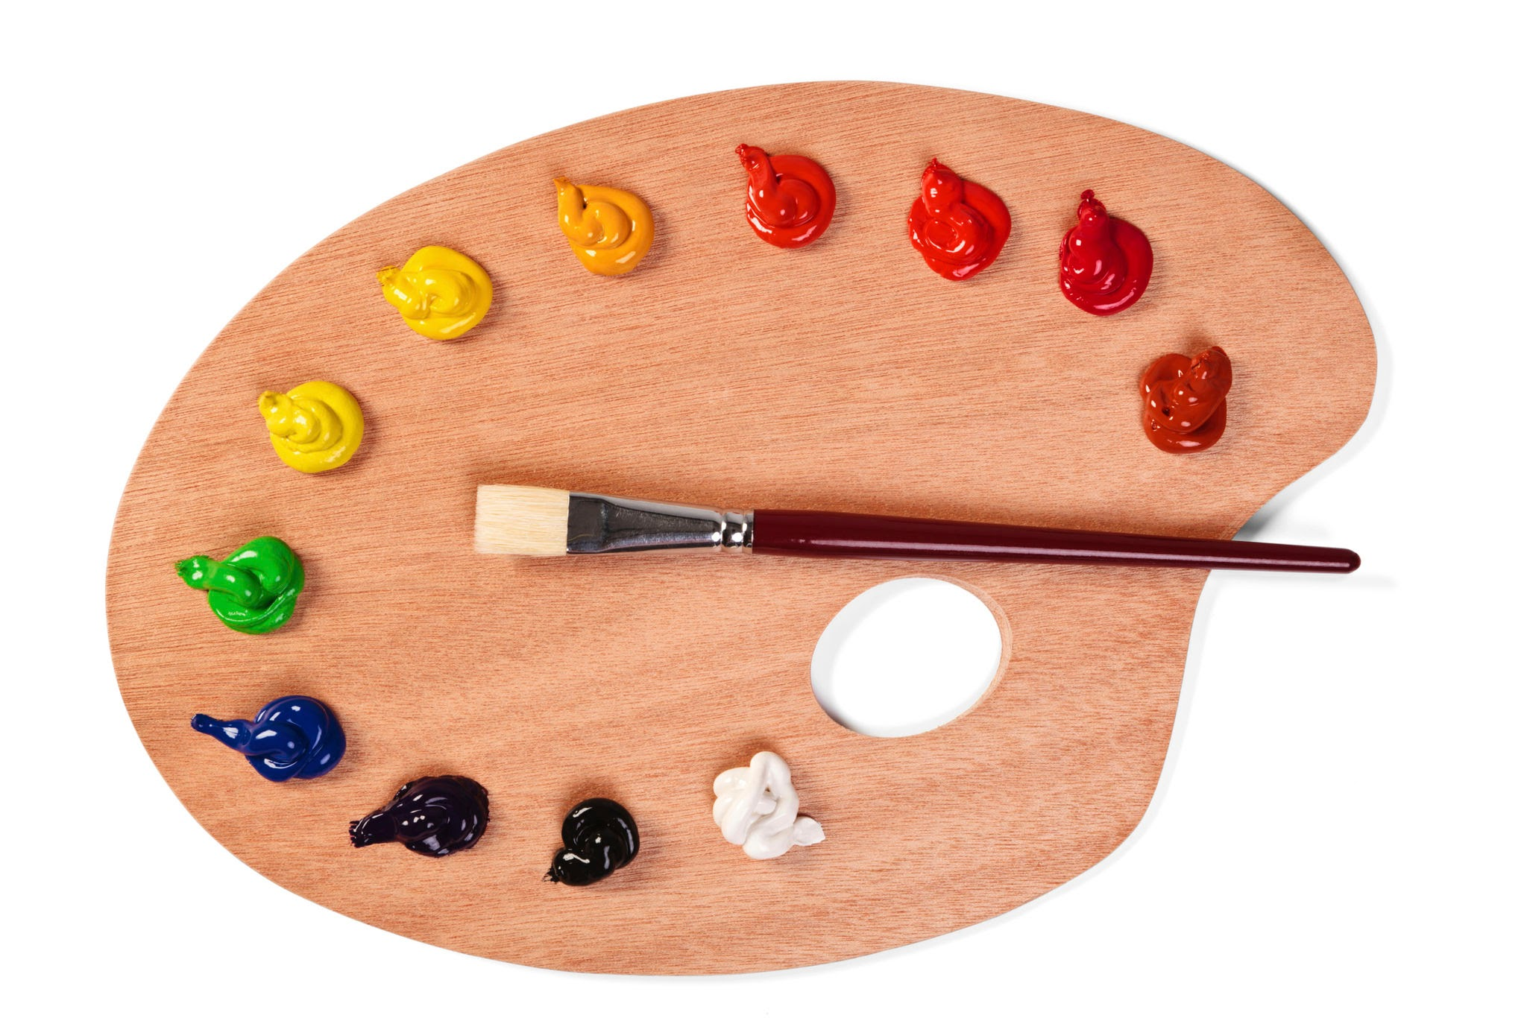

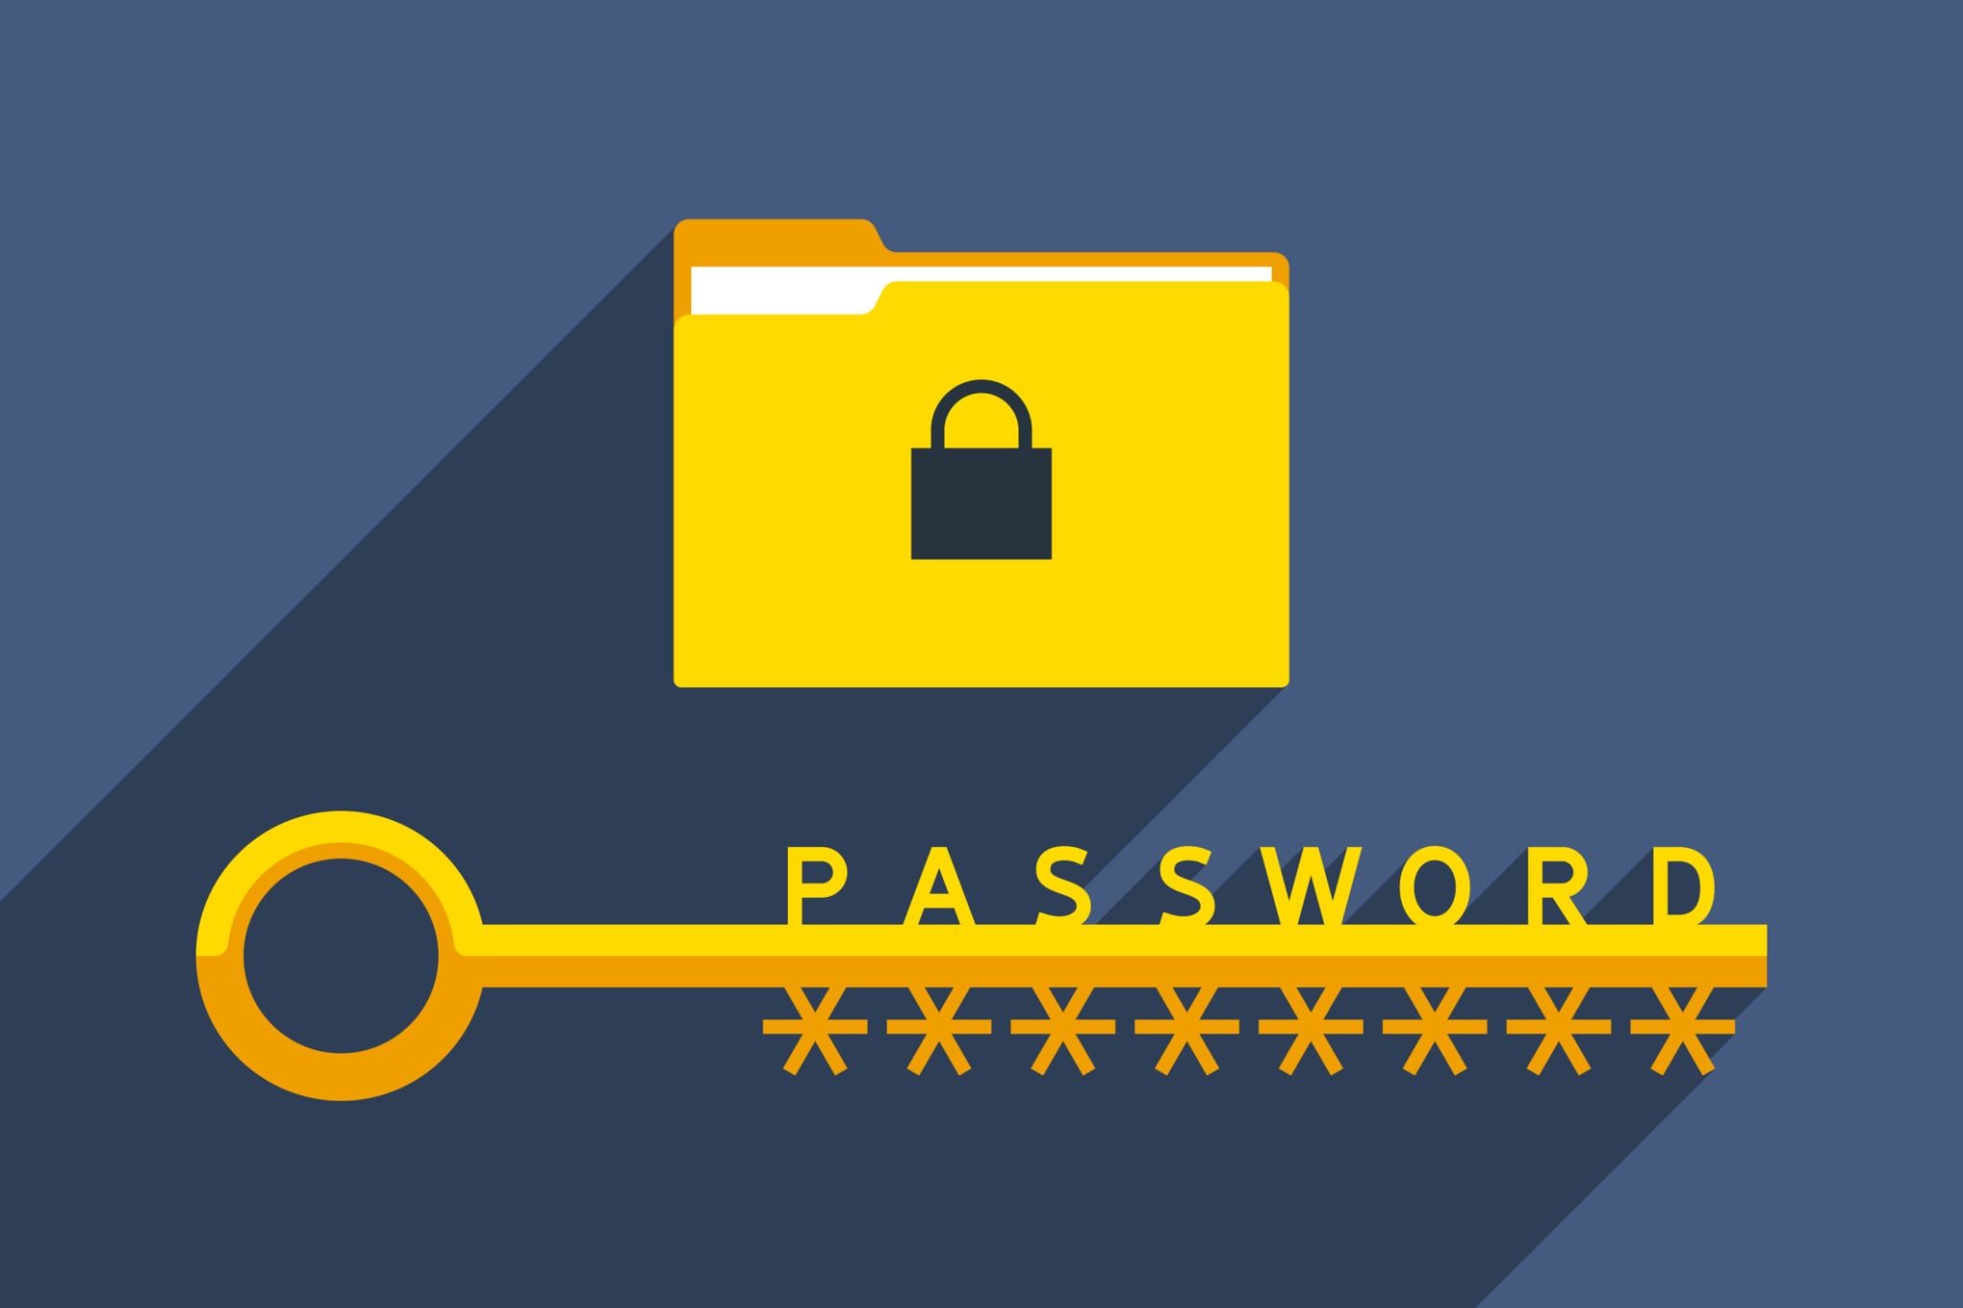

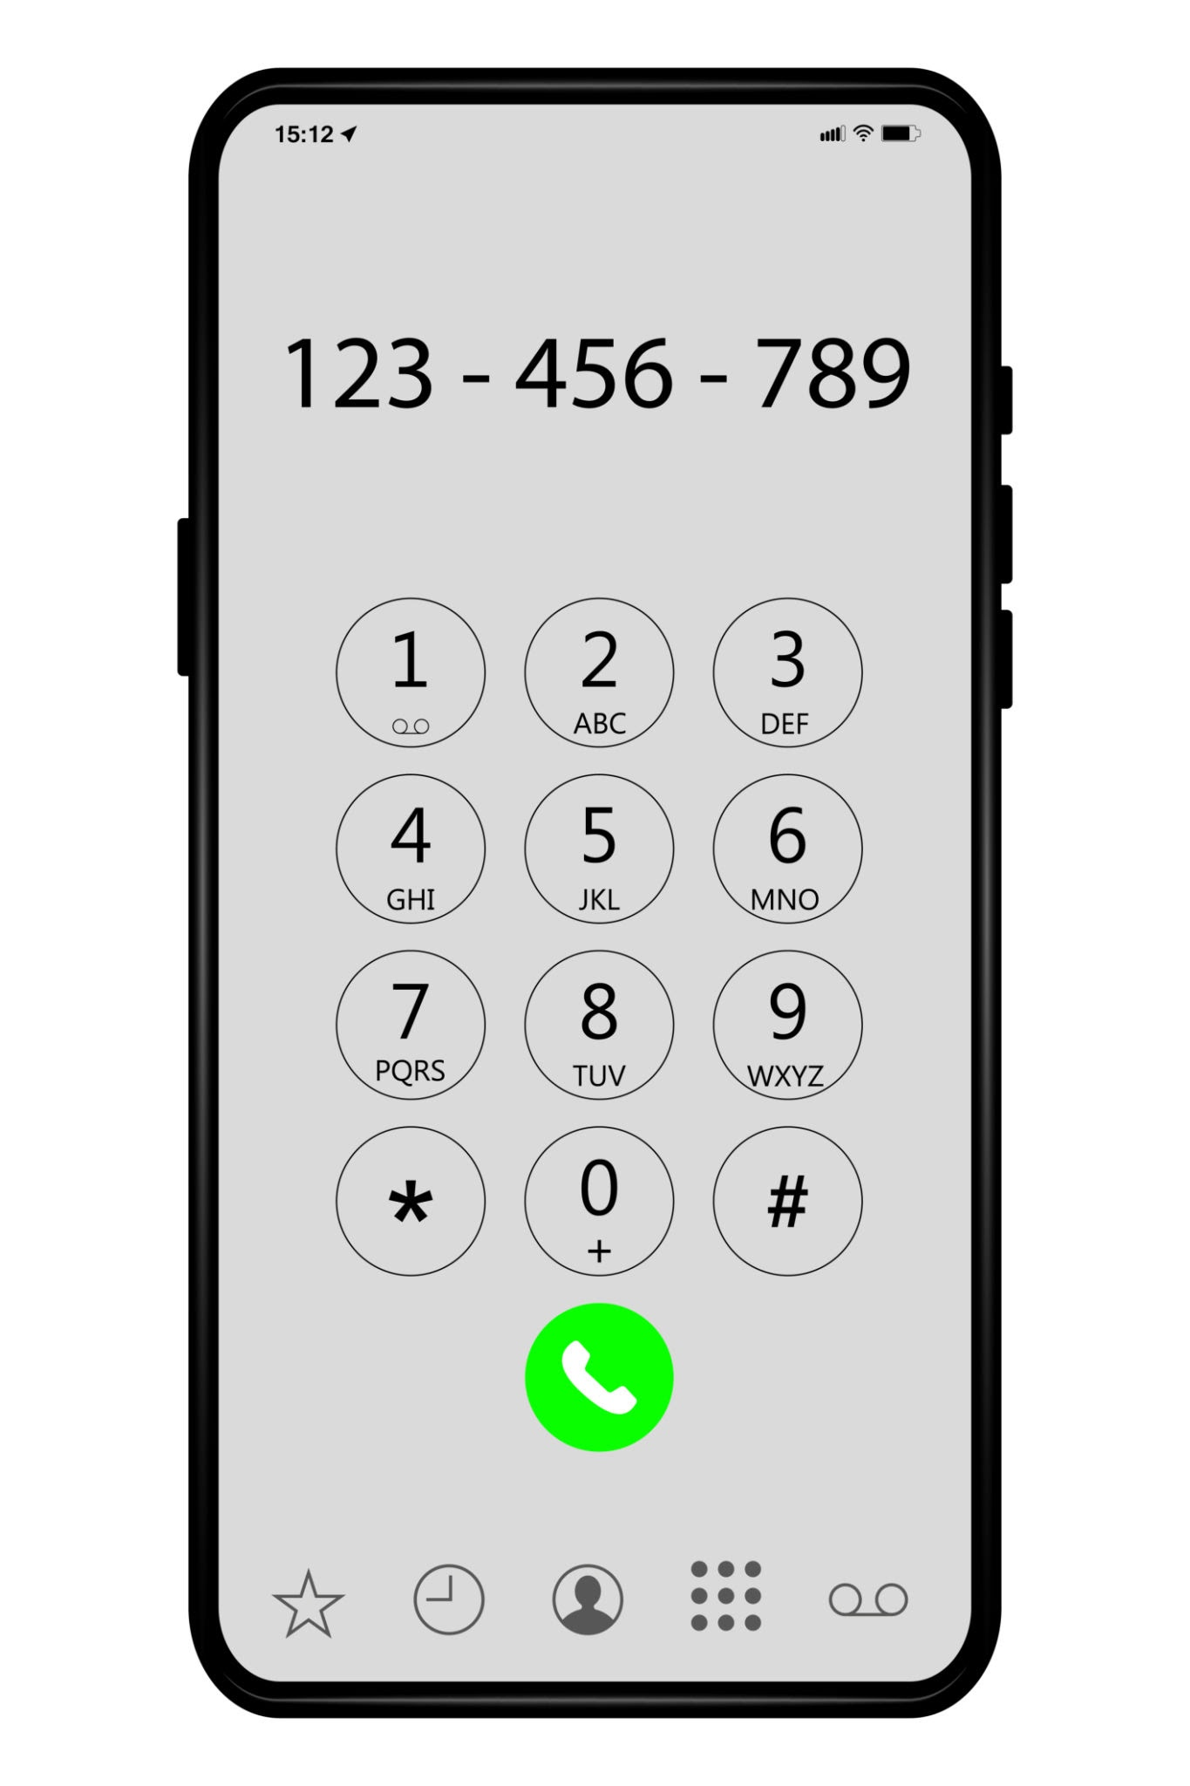



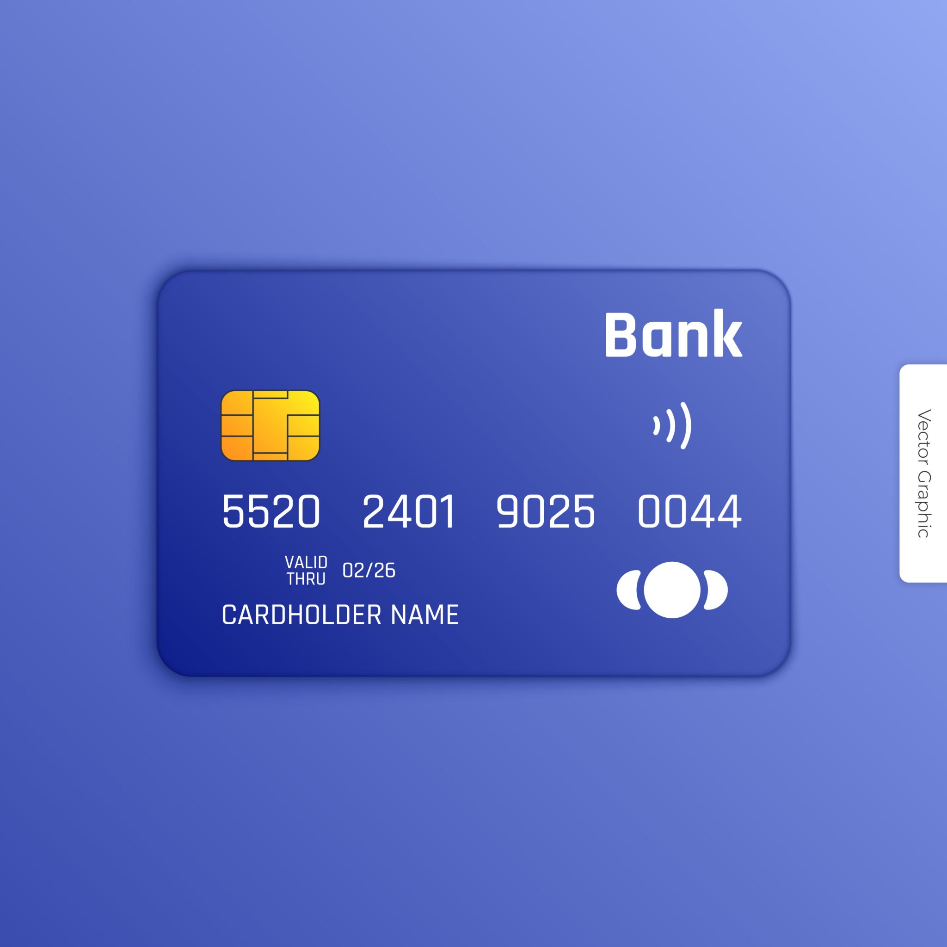


Private
Ok to share
Add 4 of your own images

Slide 3
What could happen if you share private information online?
If I shared my photo online,
If I share my school name online,
If I share my Google password online,

Slide 4


Top Tips
Strong password (letters, numbers and symbols)
Use a nickname MsR007
No real photo - Avatar
Ask for help!!

Slide 5
Buddy coding
Different platforms
Visual representations - robots
Mini quizzes - no formal assessment
Screentime - all active screen time - no passive - healthy amount - balance - not a full lesson - always supervised

